Slide 1

University Library Database Management System
Project Overview and Implementation

Slide 2
NAMES OF PARTICIPANTS
NAMES ID NUMBER
JOSHUA KAMUNDA 2021380807
JONATHAN MWALE 2021512967
MORRIS KUNDA 2021462668
CHITUNDU NAKANYIKA 2021432084
LIMBANI PHIRI 2O21437329
PHILEMON NKANDU 2021515991

Slide 3
Project Timeline
Weeks 1-2 : Problem definition & requirements
Weeks 3-4: Data Modeling & Design
Week 9-10: Testing & Documentation
Week 5-6: SQL Implementations
Week 7-8: User Interface Development

Slide 4
Problem Definition & Requirements
Project objectives:
  Streamline library operations
  Automate book lending process
  Manage student records
  Handle fines payments
Key Requirements
  Book inventory management
  Student registration system
  Loan processing
  Final calculation

Slide 5
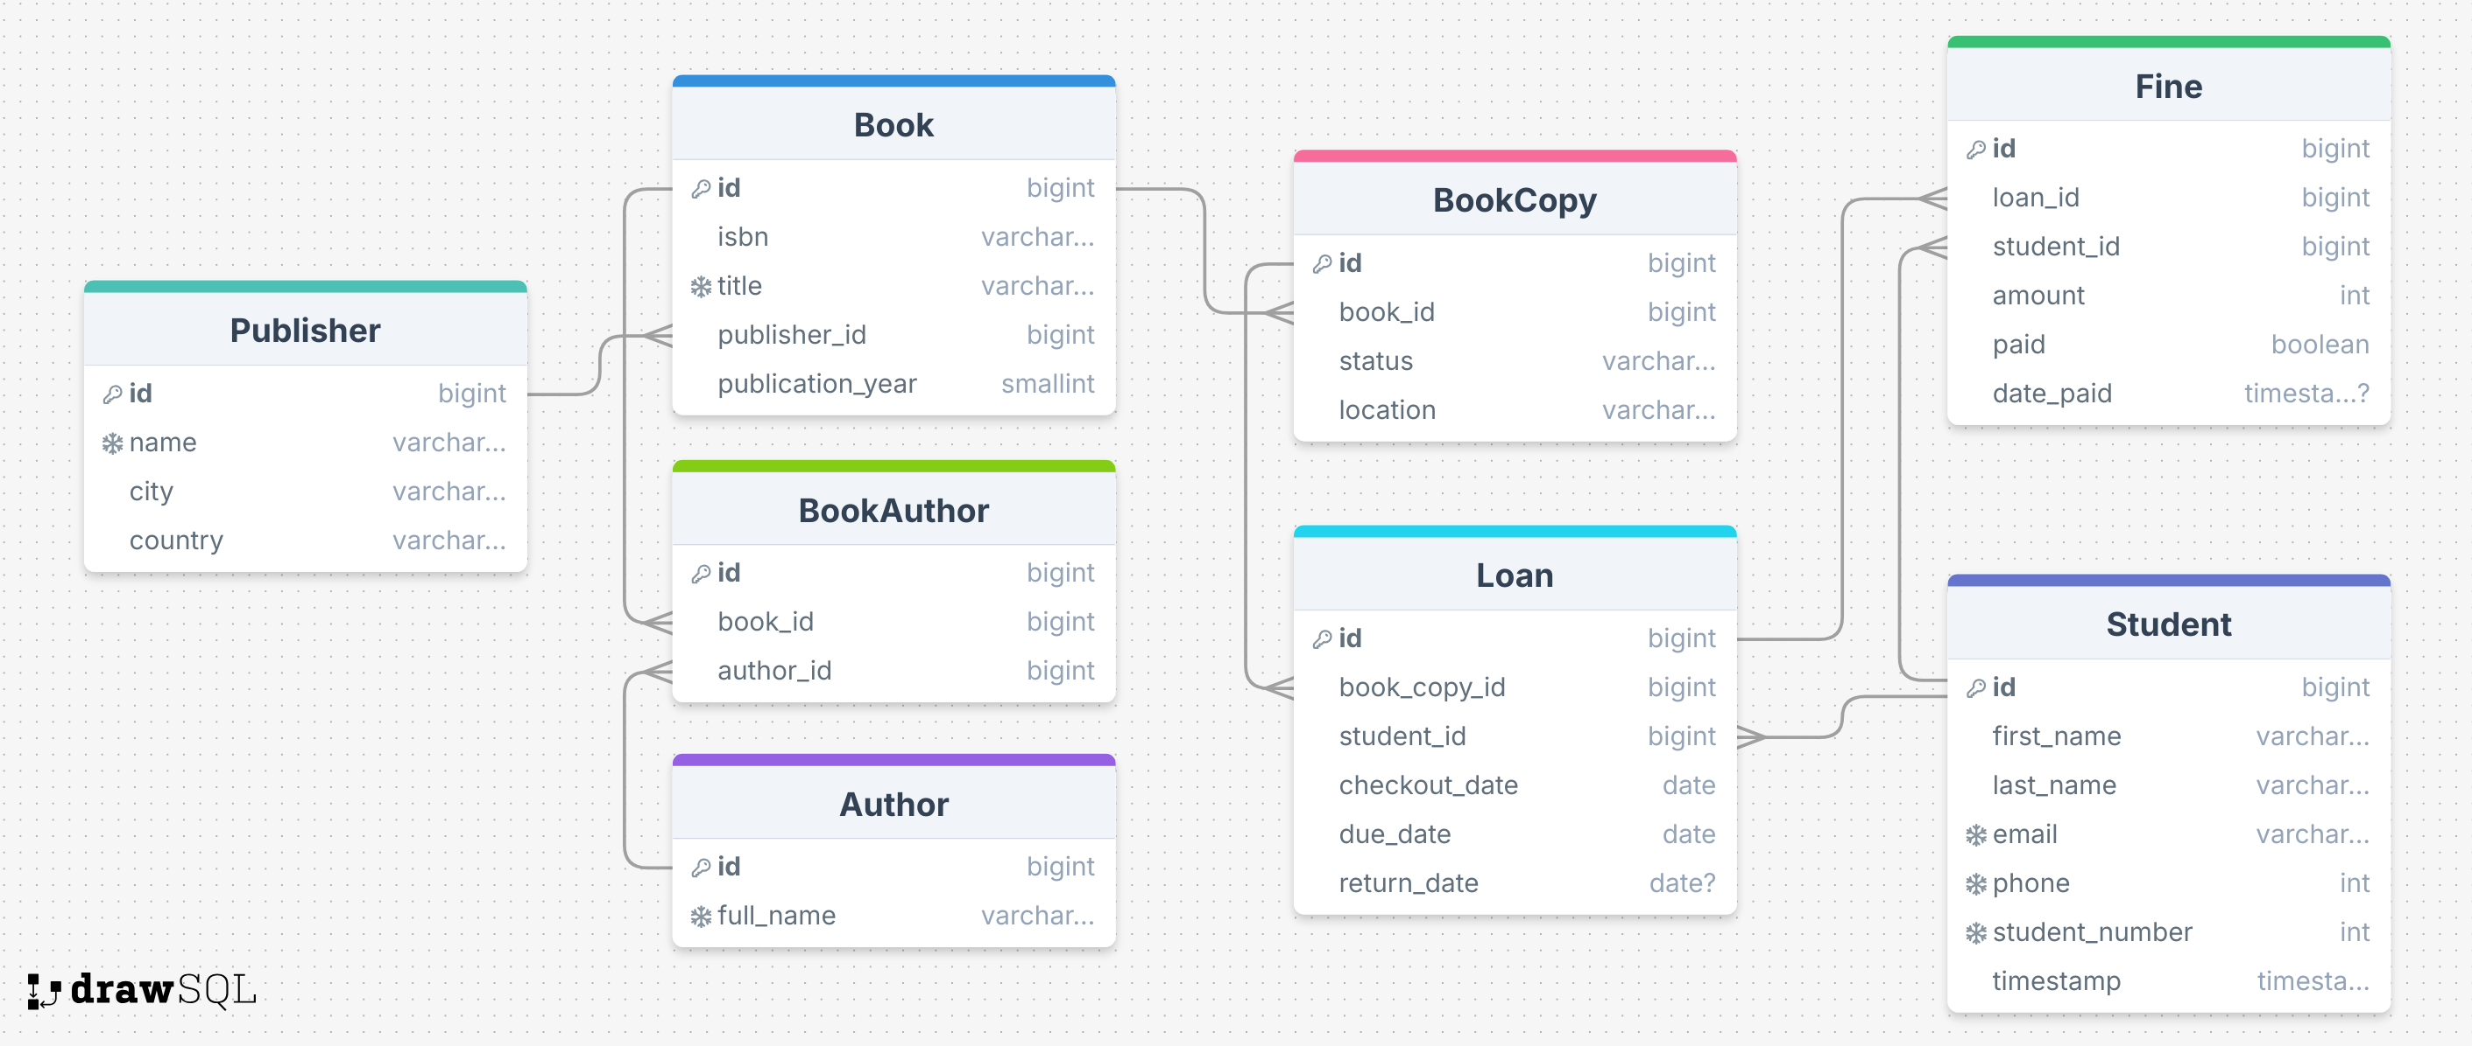
Data Model Overview

Slide 6
Entity Relationships
Student(id, first_name, last_name, email, phone, student_number, timestamp)
Publisher(id, name, city, country)
Author(id, full_name)
Book(id, isbn, title, publisher_id, publication_year)
BookAuthor(id, book_id, author_id)
BookCopy(id, book_id, status, location)
Loan(id, book_copy_id, student_id, checkout_date, due_date, return_date)
Fine(id, loan_id, student_id, amount, paid, date_paid)

Slide 7
SQL Implementation
The SQL commands used to create the tables in a postgresql database are as follows.

Slide 8
Author Table
CREATE TABLE "Author"(
"id" bigserial NOT NULL,
"full_name" VARCHAR(255) NOT NULL
);
ALTER TABLE "Author" ADD PRIMARY KEY("id");
ALTER TABLE "Author" ADD CONSTRAINT "author_full_name_unique" UNIQUE("full_name");

Slide 9
Publisher Table
CREATE TABLE "Publisher"(
"id" bigserial NOT NULL,
"name" VARCHAR(255) NOT NULL,
"city" VARCHAR(255) NOT NULL,
"country" VARCHAR(255) NOT NULL
);
ALTER TABLE "Publisher" ADD PRIMARY KEY("id");
ALTER TABLE "Publisher" ADD CONSTRAINT "publisher_name_unique" UNIQUE("name");

Slide 10
Student Table
CREATE TABLE "Student"(
"id" bigserial NOT NULL,
"first_name" VARCHAR(255) NOT NULL,
"last_name" VARCHAR(255) NOT NULL,
"email" VARCHAR(255) NOT NULL,
"phone" INTEGER NOT NULL,
"student_number" INTEGER NOT NULL,
"timestamp" TIMESTAMP(0) WITHOUT TIME ZONE NOT NULL
);
ALTER TABLE "Student" ADD PRIMARY KEY("id");
ALTER TABLE "Student" ADD CONSTRAINT "student_email_unique" UNIQUE("email");
ALTER TABLE "Student" ADD CONSTRAINT "student_phone_unique" UNIQUE("phone");
ALTER TABLE "Student" ADD CONSTRAINT "student_student_number_unique" UNIQUE("student_number");

Slide 11
Book Table
CREATE TABLE "Book"(
"id" bigserial NOT NULL,
"isbn" VARCHAR(13) NOT NULL,
"title" VARCHAR(255) NOT NULL,
"publisher_id" BIGINT NOT NULL,
"publication_year" SMALLINT NOT NULL
);
ALTER TABLE "Book" ADD PRIMARY KEY("id");
ALTER TABLE "Book" ADD CONSTRAINT "book_title_unique" UNIQUE("title");

Slide 12
BookAuthor Table
CREATE TABLE "BookAuthor"(
"id" bigserial NOT NULL,
"book_id" BIGINT NOT NULL,
"author_id" BIGINT NOT NULL
);
ALTER TABLE "BookAuthor" ADD PRIMARY KEY("id");

Slide 13
BookCopy Table
CREATE TABLE "BookCopy"(
"id" bigserial NOT NULL,
"book_id" BIGINT NOT NULL,
"status" VARCHAR(50) NOT NULL,
"location" VARCHAR(255) NOT NULL
);
ALTER TABLE "BookCopy" ADD PRIMARY KEY("id");

Slide 14
Loan Table
CREATE TABLE "Loan"(
"id" bigserial NOT NULL,
"book_copy_id" BIGINT NOT NULL,
"student_id" BIGINT NOT NULL,
"checkout_date" DATE NOT NULL,
"due_date" DATE NOT NULL,
"return_date" DATE NULL
);
ALTER TABLE "Loan" ADD PRIMARY KEY("id");

Slide 15
Fine Table
CREATE TABLE "Fine"(
"id" bigserial NOT NULL,
"loan_id" BIGINT NOT NULL,
"student_id" BIGINT NOT NULL,
"amount" INTEGER NOT NULL,
"paid" BOOLEAN NOT NULL,
"date_paid" TIMESTAMP(0) WITH TIME ZONE NULL
);
ALTER TABLE "Fine" ADD PRIMARY KEY("id");

Slide 16
User Interface Features
The UI was implemented using the following tech stack:
Languages: Python
Backend Framework: Django
Frontend : HTML, Tailwindcss, AlpineJS & HTMX
Database: PostgreSQL
Admin Interface: Django Admin with Unfold
Form Management: Django Forms

Slide 17
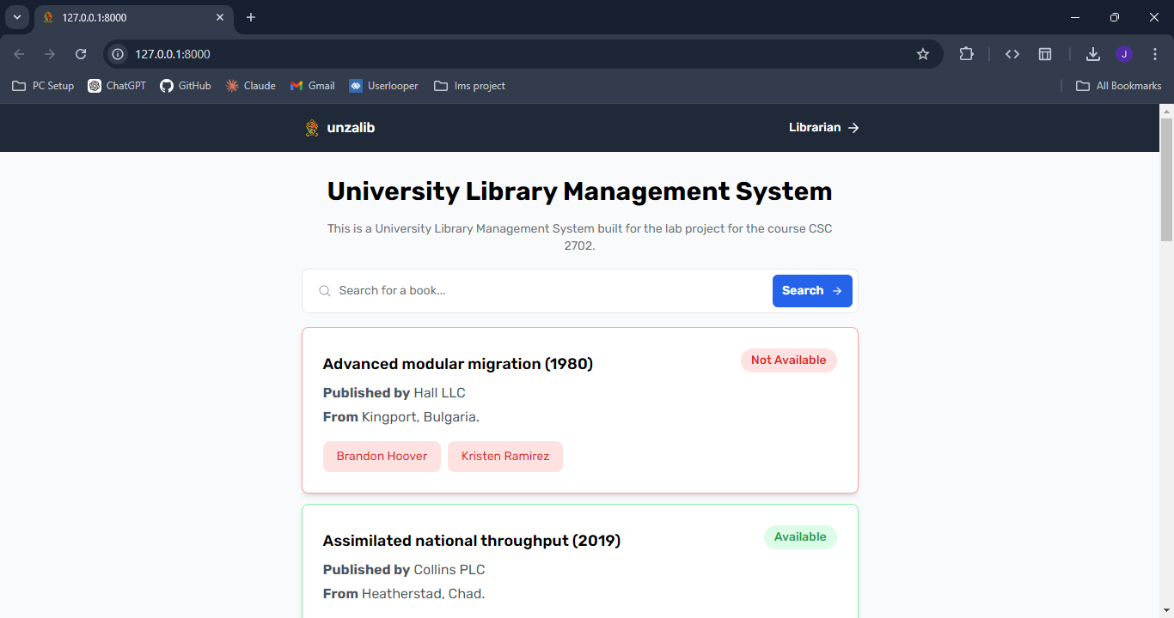

Slide 18
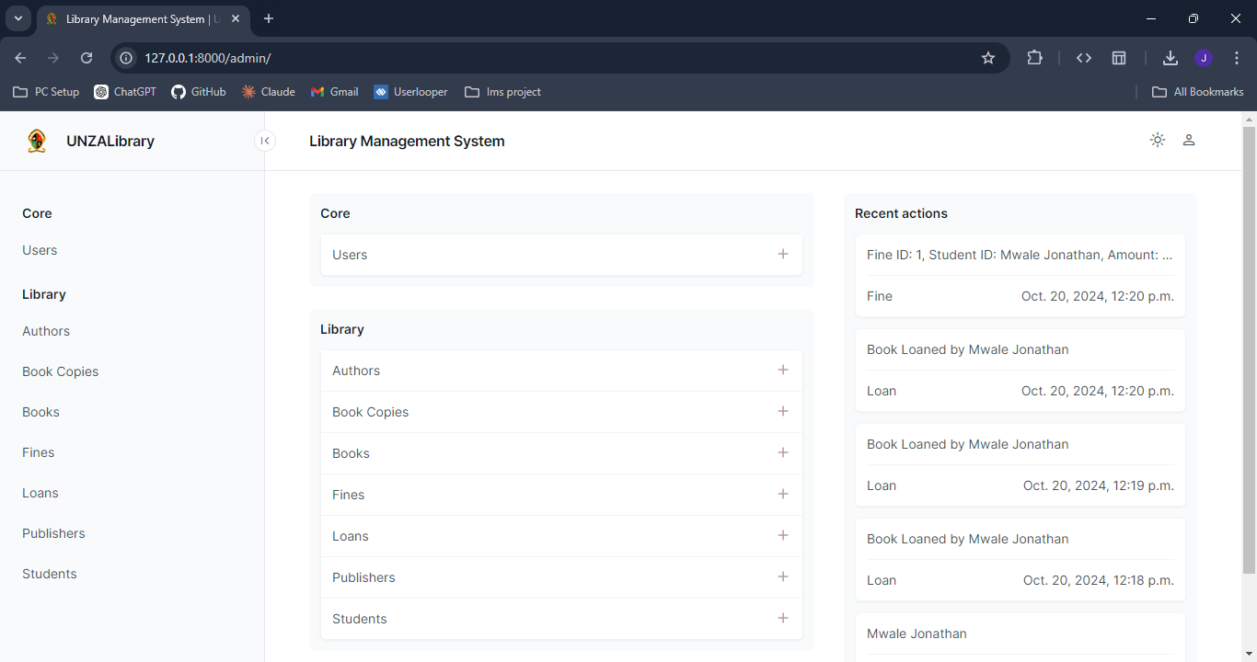

Slide 19
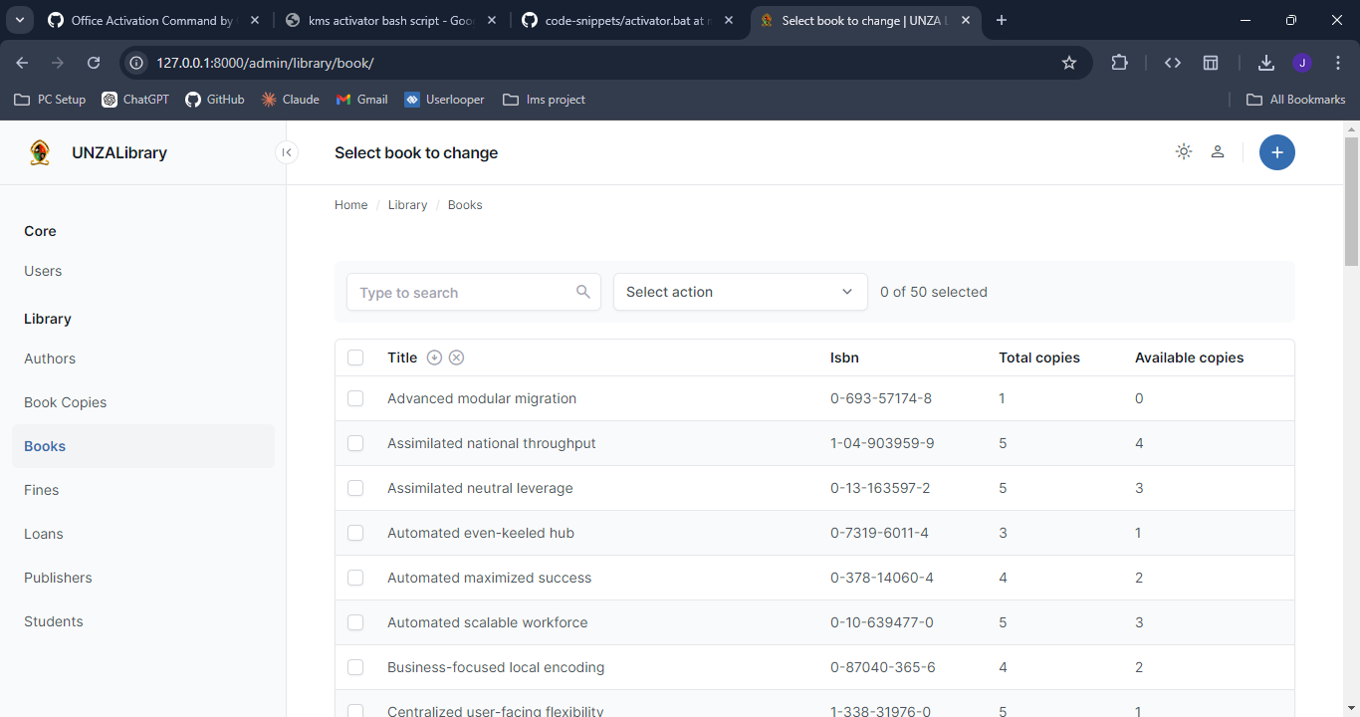

Slide 20
Testing & Documentation
Entity | Operation | Test Case Description | Expected Result | Pass/Fail
Publisher | Create | Add a new publisher | Successful insertion | Pass
Publisher | Create | Create Duplicate | Try to create a publisher with existing name | Error: Duplicate entry
Author | Create | Add a new author | Successful insertion | Pass
Author | Create | Create Duplicate | Try to create an author with existing name | Error: Duplicate entry
Book | Create | Add a new book | Successful insertion | Pass
Book | Create | Create Duplicate Title | Try to create a book with existing title | Error: Duplicate entry
Student | Create | Add a new student | Successful insertion | Pass
Student | Create | Create Duplicate Email | Try to create a student with existing email | Error: Duplicate entry
Loan | Process Loan | Successfully process book loan |  | Pass
Fine | Process Fine | Test fine generation for overdue books |  | Pass

Slide 21
Project Outcomes
Success Metrics:
Fully functional DBMS
Efficient data management
User friendly interface
Comprehensive documentation

Slide 22
Thank You

